Slide 1
Vulnerability Management/Open VAS with Green bone
Felecia Moore

Slide 2
Agenda
Create a Vulnerability Management Server Using OpenVAS
Install Insecure Software on a Virtual Machine
Perform Scans and do remediation

Slide 3
Resume Entry
Set up a secure Azure network with OpenVAS Vulnerability Management Scanner VM.
Developed a vulnerable Windows 10 VM, featuring outdated software and disabled system controls.
Performed unauthenticated and credentialed vulnerability scans using OpenVAS
Analyzed scan results, highlighting the difference between unauthenticated and credentialed scans.
Remediated identified vulnerabilities, verified successful remediation through subsequent scans.
Created a list of remediable vulnerabilities to simulate realistic, vulnerability remediation scenarios.

Slide 4
Objectives
Create Azure Account
Prepare Vulnerability Management Scanner
Create Client Virtual Machine and Make it Vulnerable
Perform Unauthenticated Scan
Make Configurations for Authenticated Scans (Within VM)
Make Configurations for Unauthenticated Scans (OpenVAS)
Perform Authenticated Scan against our Vulnerable Windows client.
Remediate Vulnerabilities
Verify Remediations
Reporting

Slide 5
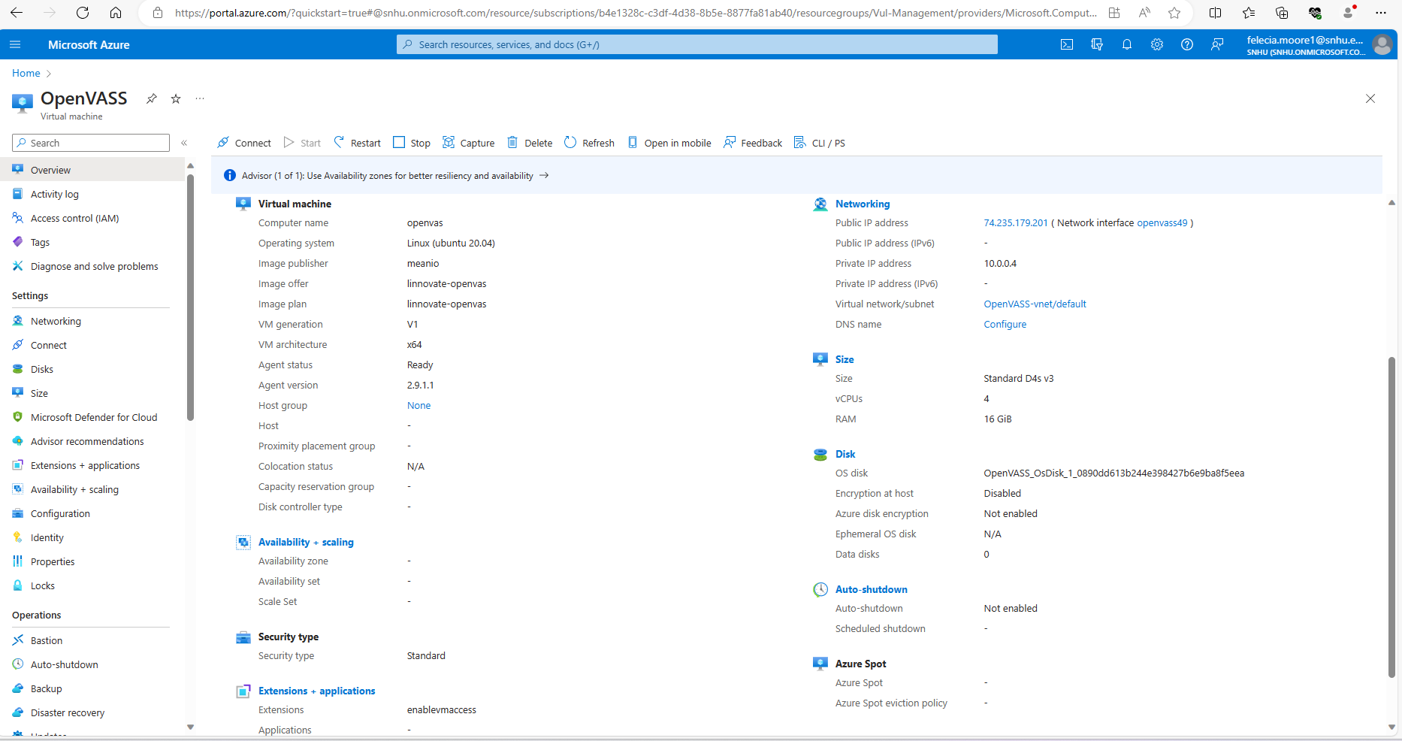
OpenVAS

Slide 6
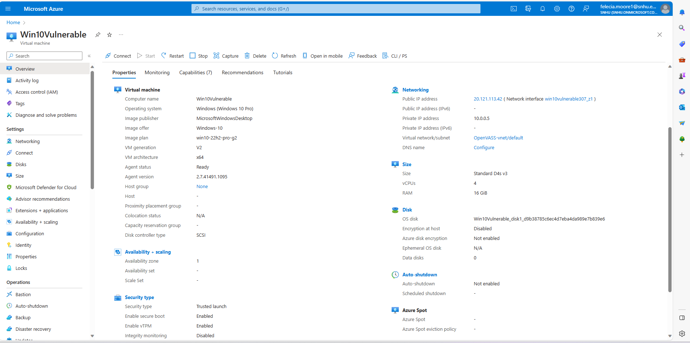
Client Virtual Machine

Slide 7
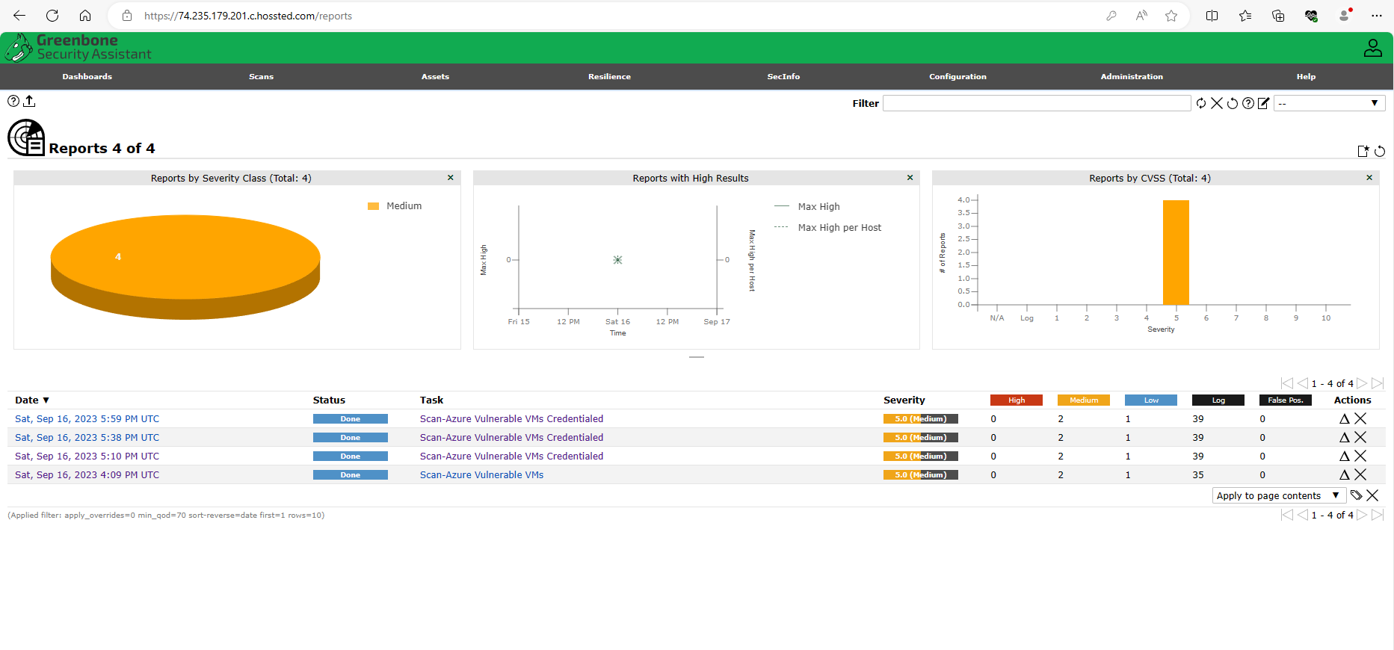
Scans with Greenbone

Slide 8
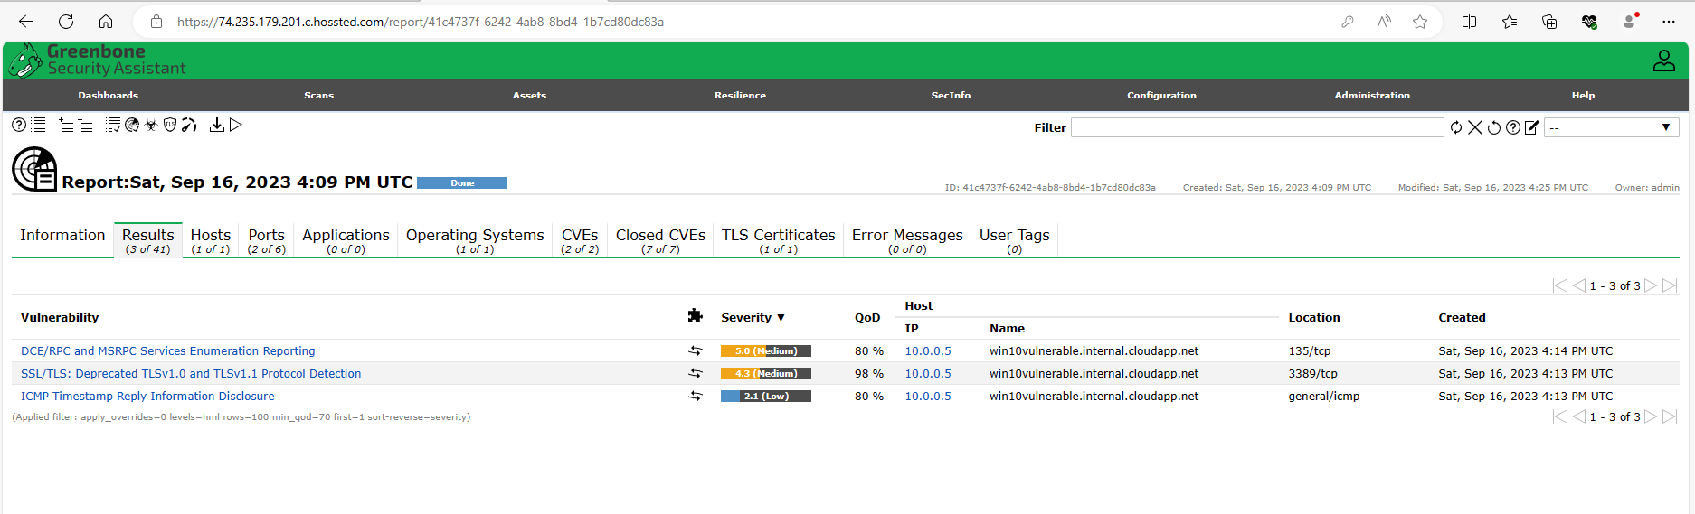
Uncredentialed Scans

Slide 9
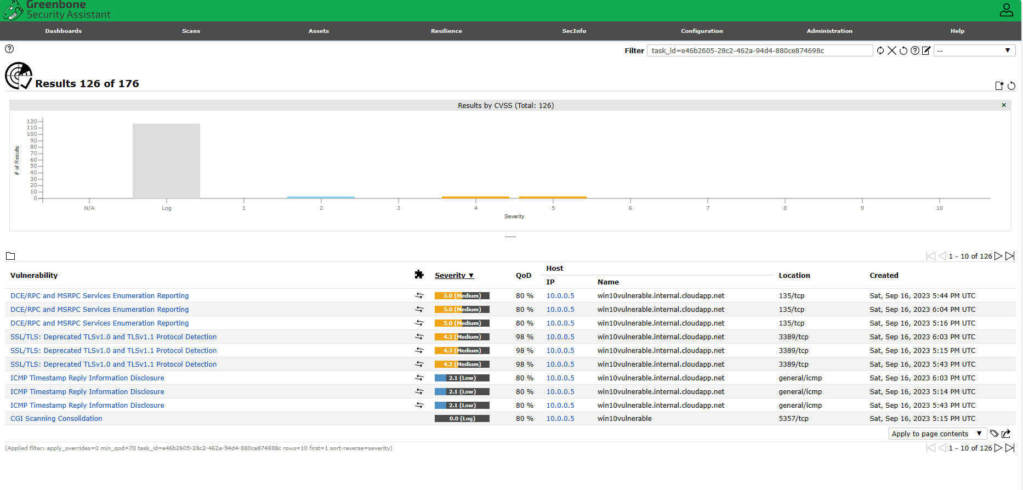
Credentialed Scans

Slide 10
Vulnerability Remediation
Remediating the vulnerabilities included logging back into the Windows 10 system, uninstalling the vulnerable software (Adobe Reader, VLC Player and Firefox), and then restarting the VM. I verified the remediations by reinitiating the Azure Credentialed Scan and observing the results.

Slide 11
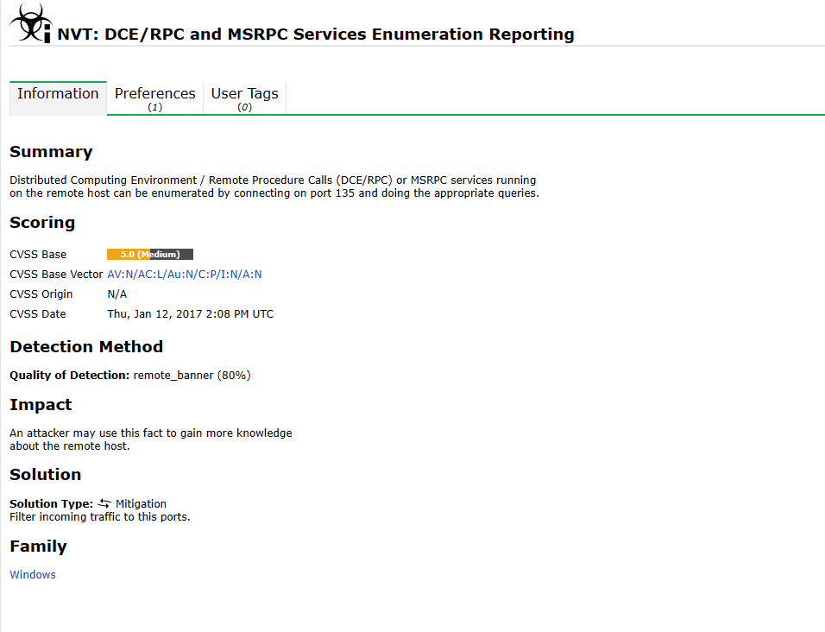
Vulnerability Reporting Example

Slide 12
Thank you
Felecia Moore​
summerrose1734@gmail.com

